Slide 1
Evaluation of the Effectiveness of HIV Assistance
Team Members: Kelly Berdelle, Daniel Chen, & Aida Roxas

Slide 2
Contents
AIDS Relief Funding Goal
3
Project Goal
4
Project Scope
5
Methodology
6
Data Preparation
7
AHP & DEA Models
10
Linear Regression
19
Hypothesis Testing
27
Conclusion
29
Appendix
31
2

Slide 3
AIDS Relief Funding Goal
90%
of those with HIV/AIDS know their
status
90%
of those people are receiving Antiretroviral Treatment
90%
of those people see improved
health
3
Notes:
To achieve by 2020
Will enable the world to end the AIDS epidemic by 2030

Slide 4
Project Goal
Develop an
Efficient Frontier
of countries receiving AIDS relief funding to evaluate their effectiveness
4

Slide 5
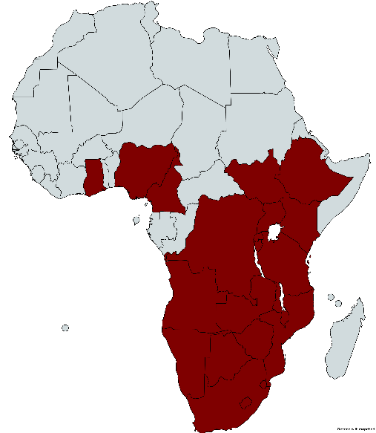
Project Scope
Ghana
Nigeria
Cameroon
DR of the Congo
Angola
Zambia
Botswana
Namibia
Lesotho
South Africa
South Sudan
Ethiopia
Uganda
Kenya
Rwanda
Burundi
Tanzania
Malawi
Zimbabwe
Mozambique
Swaziland
5
Notes:
Sub-Sahara is home to 6.2% of the world’s population but has 19 million people living with HIV, over 50% of the total number of people living with HIV in the world. In 2015, there were 960,000 new HIV infections, 46% of the global total.
South Africa accounted for 40% of the region’s new infections in 2015, with another 50% occurring in eight countries: Ethiopia, Kenya, Malawi, Mozambique, Uganda, the United Republic of Tanzania (Tanzania), Zambia and Zimbabwe

Slide 6
Methodologies
Analytical
Hierarchy
Process (AHP)
Data
Preparation
&
Linear
Regression
Data Envelopment
Analysis (DEA)
Gather Data
Determine Timeline
Select Inputs & Outputs
Compute Performance & Efficiency Scores
Discover Predictors
6
Notes:
DEA to compute efficiency; AHP to compute performance (of the 5 output measures)

Slide 7
Data Sources
Index
Mundi
UNAIDS
The World Bank
CIA World Fact Book
Science Direct
IAPAC
WHO
AVERT
7

Slide 8
Data Timeline
2006
2007
2008
2009
2010
2011
2012
2013
2014
Inputs
Outputs
8

Slide 9
Model Inputs & Outputs
Percentage Decline in New HIV Infections Among Children
(2009-2014)
PEPFAR Funding
Percentage of Infants Born to Women Living with HIV Receiving a Virological Test within Two Months (2014)
Aggregated Funding
Domestic Funding
Percentage of Pregnant Women Living with HIV Receiving Antiretroviral Therapy (2014)
?
Percentage of Children Living with HIV Receiving Antiretroviral Therapy
(2014)
The Global Fund
Percentage of Children Exposed to HIV Receiving Co-Trimoxazole
(2014)
9

Slide 10
AHP Model Weighting
20
Percentage Decline in New HIV Infections Among Children
(2009-2014)
Percentage of Infants Born to Women Living with HIV Receiving a Virological Test within Two Months (2014)
3
Percentage of Pregnant Women Living with HIV Receiving Antiretroviral Therapy (2014)
9
Percentage of Children Living with HIV Receiving Antiretroviral Therapy
(2014)
5
Percentage of Children Exposed to HIV Receiving Co-Trimoxazole
(2014)
1
10

Slide 11
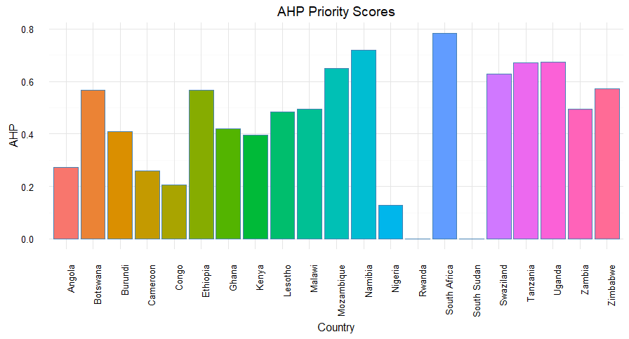
AHP Priority Scores
11

Slide 12
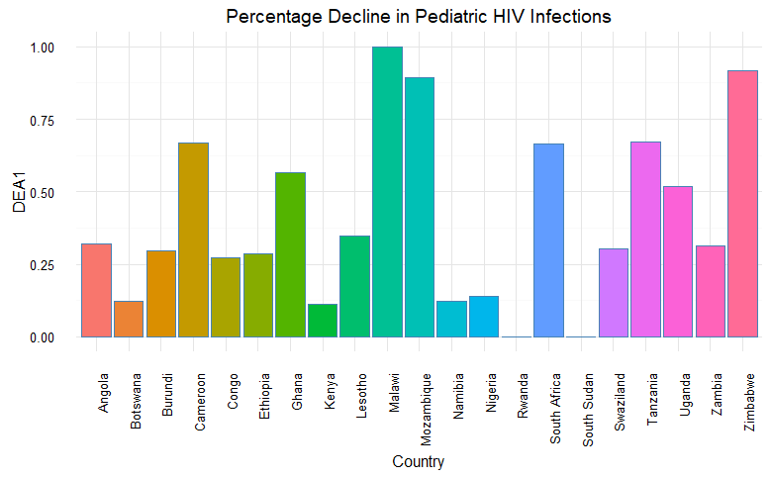
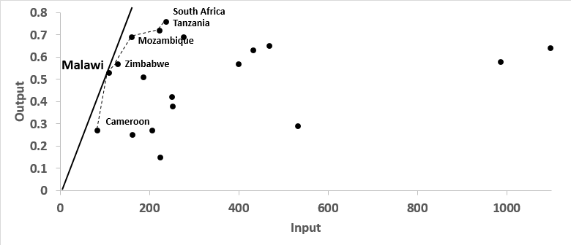
DEA Efficient Frontiers
12

Slide 13
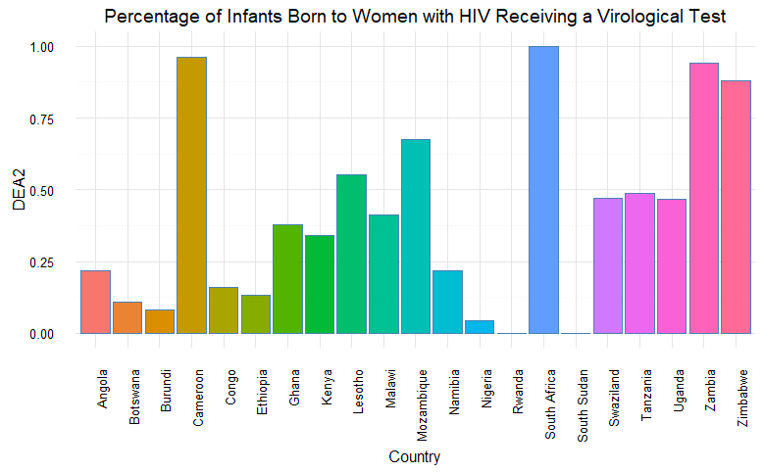
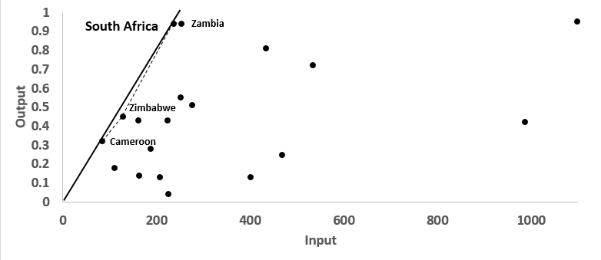
DEA Efficient Frontiers
13

Slide 14
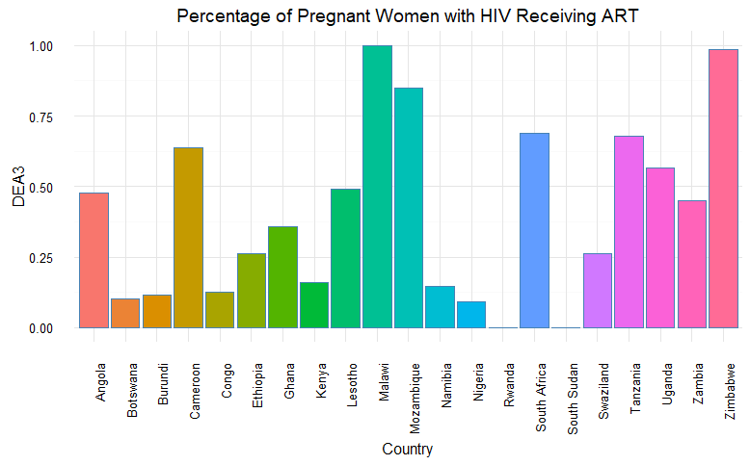
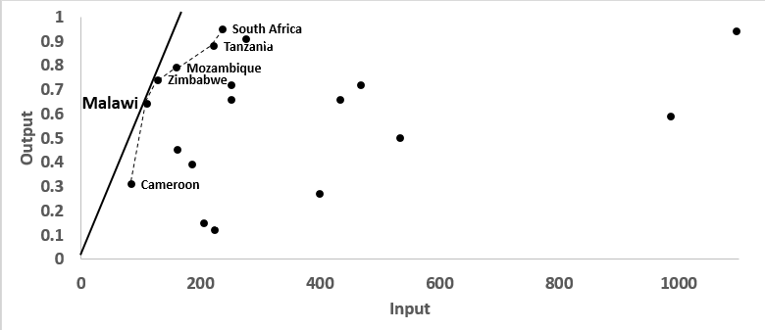
DEA Efficient Frontiers
14

Slide 15
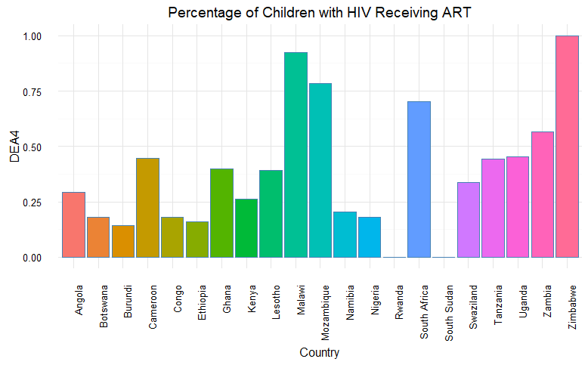
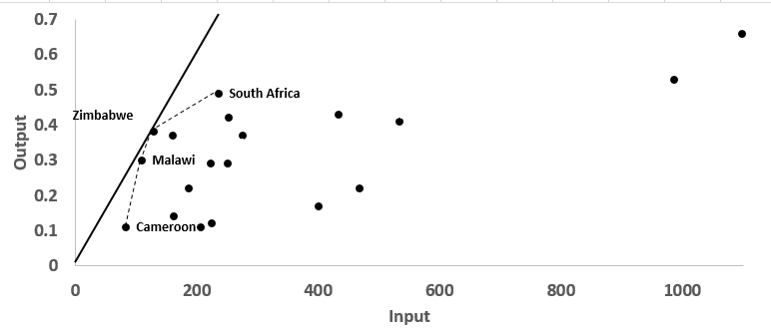
DEA Efficient Frontiers
15

Slide 16
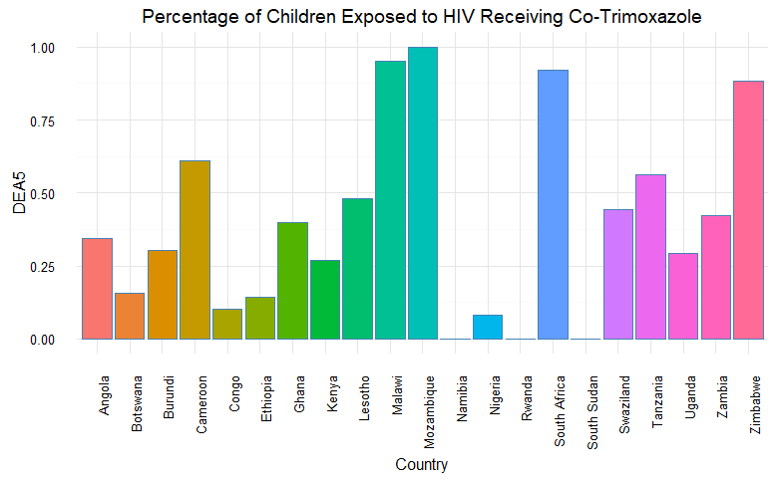
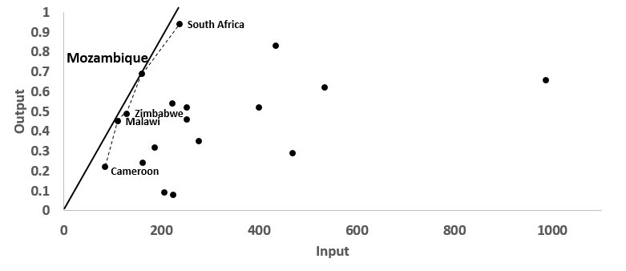
DEA Efficient Frontiers
16

Slide 17
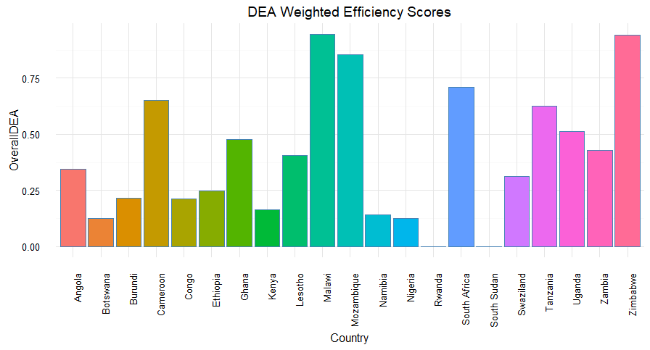
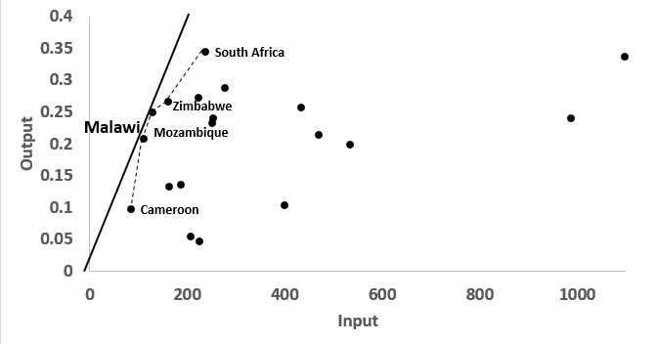
DEA Efficient Frontiers
17

Slide 18
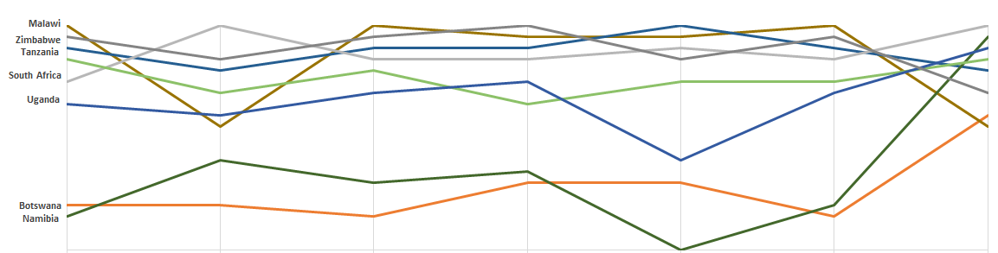
DEA Model Comparison
1
2
3
4
5
Weighted DEA
AHP
18

Slide 19
Predictor Discovery
Percentage Decline in New HIV Infections Among Children
(2009-2014)
Percentage of Infants Born to Women Living with HIV Receiving a Virological Test within Two Months (2014)
Aggregated Funding
Percentage of Pregnant Women Living with HIV Receiving Antiretroviral Therapy (2014)
?
Linear Regression
Percentage of Children Living with HIV Receiving Antiretroviral Therapy
(2014)
Percentage of Children Exposed to HIV Receiving Co-Trimoxazole
(2014)
19
Notes:
We want to identify the predictors that may explain the priority scores and efficiency scores we calculated.
To do this, we are essentially trying to peer inside of the “black box” from our DEA and AHP models. We will use linear regression to attempt to identify relationships

Slide 20
Linear Regression Input Variables
Increase in Percent of Government Expenditures on Healthcare
Increase in Rule of Law World Governance Indicator
Increase in GDP Per Capita
Homicides Per 100,000 People
Increase in Life Expectancy at Birth
Increase in Physician Density
Increase in Control of Corruption World Governance Indicator
Net Enrollment Ratio in Primary Education
Increase in Percent of Population Under 14
Increase in Freedom World Governance Indicator
Percent of Children Under Age 5 Who Are Underweight
Percent of Population Using Improved Sanitation
Increase in Percent of Parliament Members who are Women
Increase in Political Stability World Governance Indicator
Rate of Contraceptive Use
Gender Parity in Primary Education
Increase in Teenage Fertility Rate
Increase in Regulatory Quality World Governance Indicator
Percent of Population with Access to Clean Drinking Water
Literacy Rate
20
Notes:
Collection of more than 20 socioeconomic factors
Final set of factors selected by stepwise regression

Slide 21
Linear Regression (AHP)
Formal Interpretation
Practical Interpretation
“On average, holding all other inputs constant, for a one unit increase in the percentage of children enrolled in primary school of all primary school-aged children, AHP priority score increases by
0.01 units.”
If the net primary school enrollment ratio increases, we would expect priority to increase.
If the net primary school enrollment ratio decreases, we would expect priority to decrease.
21

Slide 22
Linear Regression (AHP)
Formal Interpretation
Practical Interpretation
“On average, holding all other inputs constant, for a one unit increase in the number of homicides per 100,000 people,
AHP priority score increases by
0.008 units.”
If the number of homicides increases, we would expect priority to increase.
If the number of homicides decreases, we would expect priority to decrease.
22

Slide 23
Linear Regression (DEA)
Formal Interpretation
Practical Interpretation
“On average, holding all other inputs constant, for a one unit increase in the increase in life expectancy at birth, DEA efficiency increases by
0.08 units.”
If life expectancy at birth is increasing, we would expect efficiency to increase.
If life expectancy at birth is decreasing, we would expect efficiency to decrease.
23
Notes:
Holding all other inputs constant, for 1 unit increase in the increase in life expectancy at birth, DEA efficiency increases by ~0.08 on average.
Holding all other inputs constant, for 1 unit increase in the increase in teenager fertility rate, DEA efficiency drops by ~0.009 on average.
Holding all other inputs constant, for 1 unit increase in the increase in control of corruption world governance indicator, DEA efficiency drops by ~0.8 on average. Corruption is detrimental to efficiency. But does a high control-of-corruption indicator mean too much government control that stymies efficiency?

Slide 24
Linear Regression (DEA)
Formal Interpretation
Practical Interpretation
“On average, holding all other inputs constant, for a one unit increase in the increase in teenage fertility rate,
DEA efficiency decreases by
0.009 units.”
If teenage fertility rate is increasing, we would expect efficiency to decrease.
If teenage fertility rate is decreasing, we would expect efficiency to increase.
24
Notes:
Holding all other inputs constant, for 1 unit increase in the increase in life expectancy at birth, DEA efficiency increases by ~0.08 on average.
Holding all other inputs constant, for 1 unit increase in the increase in teenager fertility rate, DEA efficiency drops by ~0.009 on average.
Holding all other inputs constant, for 1 unit increase in the increase in control of corruption world governance indicator, DEA efficiency drops by ~0.8 on average. Corruption is detrimental to efficiency. But does a high control-of-corruption indicator mean too much government control that stymies efficiency?

Slide 25
Linear Regression (DEA)
Formal Interpretation
Practical Interpretation
“On average, holding all other inputs constant, for a one unit increase in the increase in control of corruption World Governance Indicator,
DEA efficiency
decreases by
0.8 units.”
If control of corruption is increasing, we would expect efficiency to decrease.
If control of corruption is decreasing, we would expect efficiency to increase.
25
Notes:
Holding all other inputs constant, for 1 unit increase in the increase in life expectancy at birth, DEA efficiency increases by ~0.08 on average.
Holding all other inputs constant, for 1 unit increase in the increase in teenager fertility rate, DEA efficiency drops by ~0.009 on average.
Holding all other inputs constant, for 1 unit increase in the increase in control of corruption world governance indicator, DEA efficiency drops by ~0.8 on average. Corruption is detrimental to efficiency. But does a high control-of-corruption indicator mean too much government control that stymies efficiency?

Slide 26
Regression Insights
Model
AHP
DEA
If life expectancy at birth increases, DEA efficiency increases
If teenage fertility rate decreases, DEA efficiency increases
If the net primary school ratio increases, AHP priority score increases
In line with
expectations
Result
If the number of homicides increase, AHP priority score increases
If control of corruption decreases, DEA efficiency increases
Out of line with
expectations
26
Notes:
Life Expectancy at Birth is an indicator of the quality of life and quality of health care. It makes sense that having good medical care in place can enhance the efficiency of combating the HIV epidemic.
Adolescent fertility, also known as teenage fertility, refers to a condition where woman has given live birth before the age of 20 years. It has an adverse effect on AIDS relief efficiency. A higher prevalence of sexual activity among young girls often leads to more unplanned pregnancies, unsafe abortion, and contracting STIs including HIV/AIDS.
We also conducted Random Forest Modeling to see the importance levels of ALL variables: Adolescent Fertility, Control-of-Corruption Indicator, Physician Density, Life Expectancy, and Per-Capita Government Expenditure on Health are the 5 most important variables.

Slide 27
Regression Insights: Hypothesis Testing
Malawi
Mozambique
South Africa
Tanzania
Uganda
Zimbabwe
Botswana
Ethiopia
Namibia
Swaziland
High
Is there a significant difference in the net primary school ratio between the “low” and “high” AHP scoring quadrants?
AHP Priority Score
Angola
Burundi
DR of the Congo
Kenya
Nigeria
Cameroon
Ghana
Lesotho
Zambia
Low
Low
High
DEA Efficiency Score
27

Slide 28
Regression Insights: Hypothesis Testing
Malawi
Mozambique
South Africa
Tanzania
Uganda
Zimbabwe
Botswana
Ethiopia
Namibia
Swaziland
High
Is there a significant difference in the teenage fertility rate between the “low” and “high” DEA scoring quadrants?
AHP Priority Score
Angola
Burundi
DR of the Congo
Kenya
Nigeria
Cameroon
Ghana
Lesotho
Zambia
Low
Low
High
DEA Efficiency Score
28

Slide 29
Conclusion
Analytical Hierarchy Process (AHP)
Data Envelopment Analysis (DEA)
Linear Regression & Hypothesis Testing
20
Formal Interpretation
Practical Interpretation
“On average, holding all other inputs constant, for a one unit increase in the increase in life expectancy at birth, DEA efficiency increases by
0.08 units.”
If life expectancy at birth is increasing, we would expect efficiency to increase.
3
If life expectancy at birth is decreasing, we would expect efficiency to decrease.
9
Botswana
Ethiopia
Namibia
Swaziland
Malawi
Mozambique
South Africa
Tanzania
Uganda
Zimbabwe
5
AHP Priority Score
Angola
Burundi
DR of the Congo
Kenya
Nigeria
Cameroon
Ghana
Lesotho
Zambia
1
Low
High
South Africa, Namibia, Tanzania, Uganda, Swaziland, Botswana, and Mozambique perform the best relative to the importance of HIV transmission measures
DEA Efficiency Score
Cameroon, South Africa, Mozambique, Malawi, and Zimbabwe perform the best relative to their HIV relief assistance funding levels per capita
An increase in net primary school enrollment ratio and a decrease in teenage fertility rate may increase a country’s performance
29

Slide 30
Conclusion
President Barack Obama
December 1, 2011, The George Washington University
“Because we invested in anti-retroviral treatment, people who would have died… are living full and vibrant lives.”
“Because we developed new tools, more and more mothers are giving birth to children free from this disease.”
“And because of a persistent focus on awareness, the global rate of new infections and deaths is declining.”
“So make no mistake, we are going to win this fight. But the fight is not over – not by a long shot.”
30
Notes:
Because we invested in anti-retroviral treatment, people who would have died, some of whom are here today, are living full and vibrant lives. Because we developed new tools, more and more mothers are giving birth to children free from this disease. And because of a persistent focus on awareness, the global rate of new infections and deaths is declining.
So make no mistake, we are going to win this fight. But the fight is not over -- not by a long shot.
It is our hope that by uncovering some factors that help predict the efficient use of AIDS Relief funding, we can help the world as we combat the HIV/AIDS epidemic together.

Slide 31
Appendix
31

Slide 32
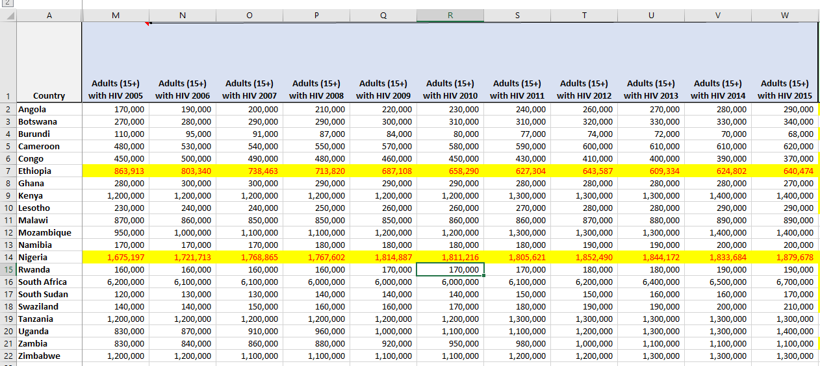
Appendix (Data Preparation)
32

Slide 33
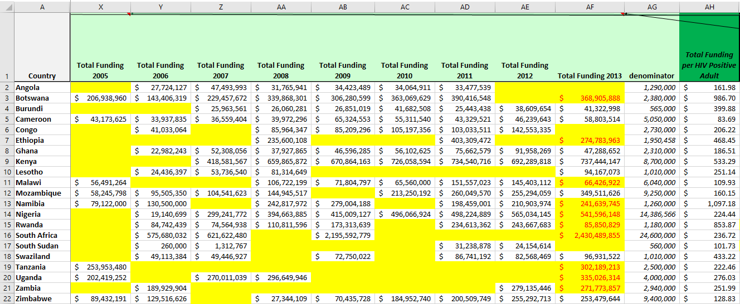
Appendix (Data Preparation)
33

Slide 34
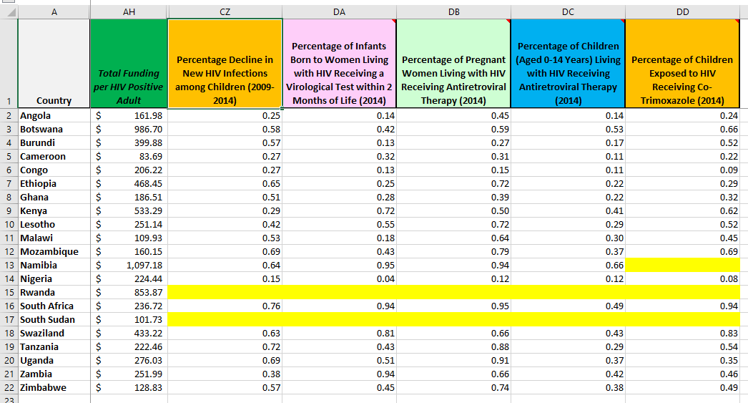
Appendix (Data Preparation)
34

Slide 35
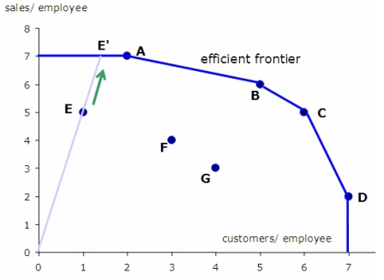
Appendix (What is DEA?)
Source: http://blog.datumbox.com/data-envelopment-analysis-tutorial/
35

Slide 36
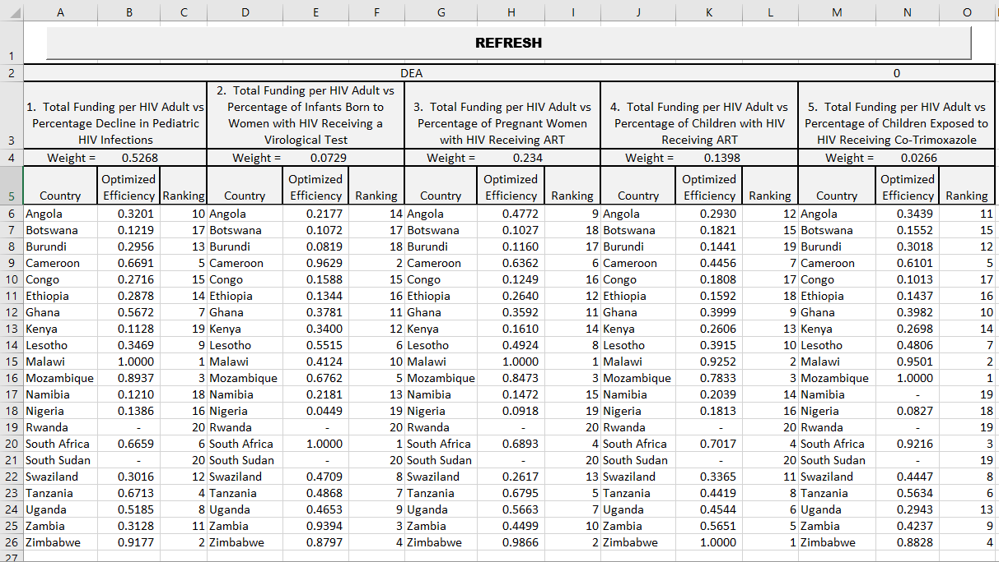
Appendix (DEA)
36

Slide 37
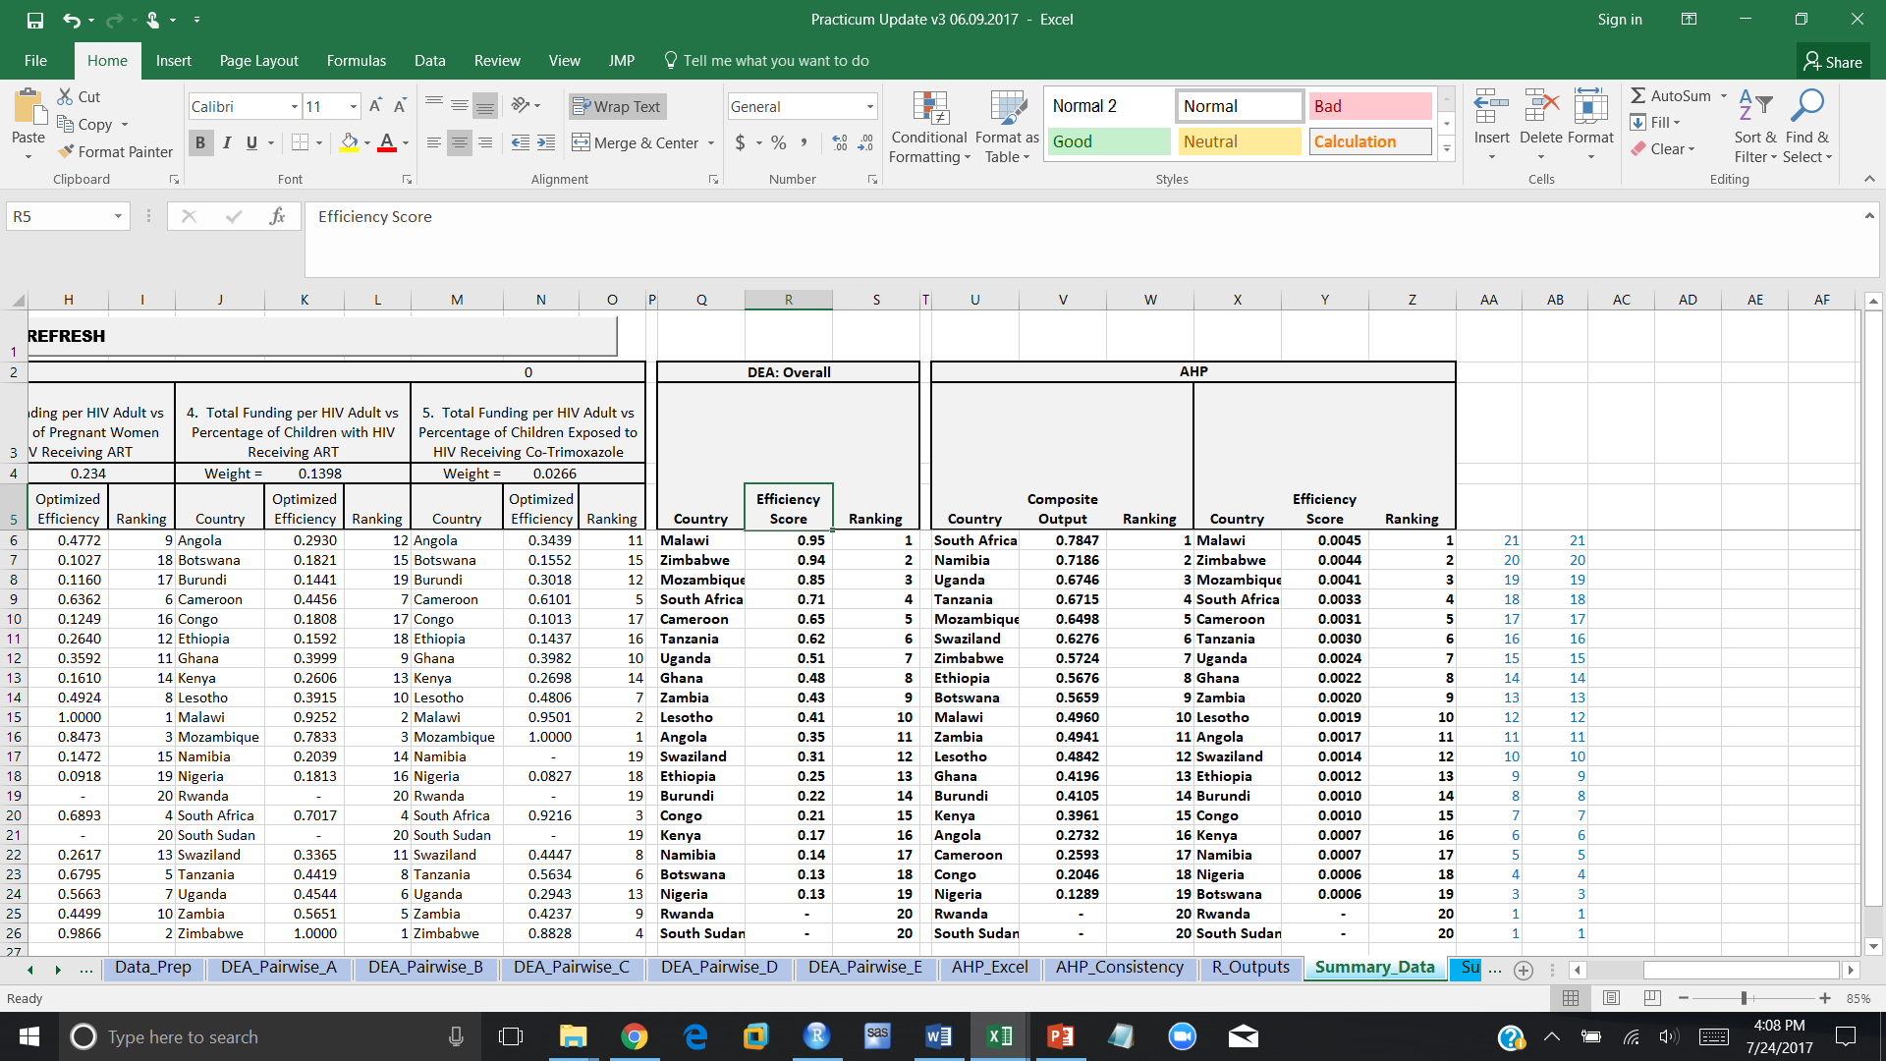
Appendix (DEA)
37

Slide 38
Appendix (AHP)
38

Slide 39
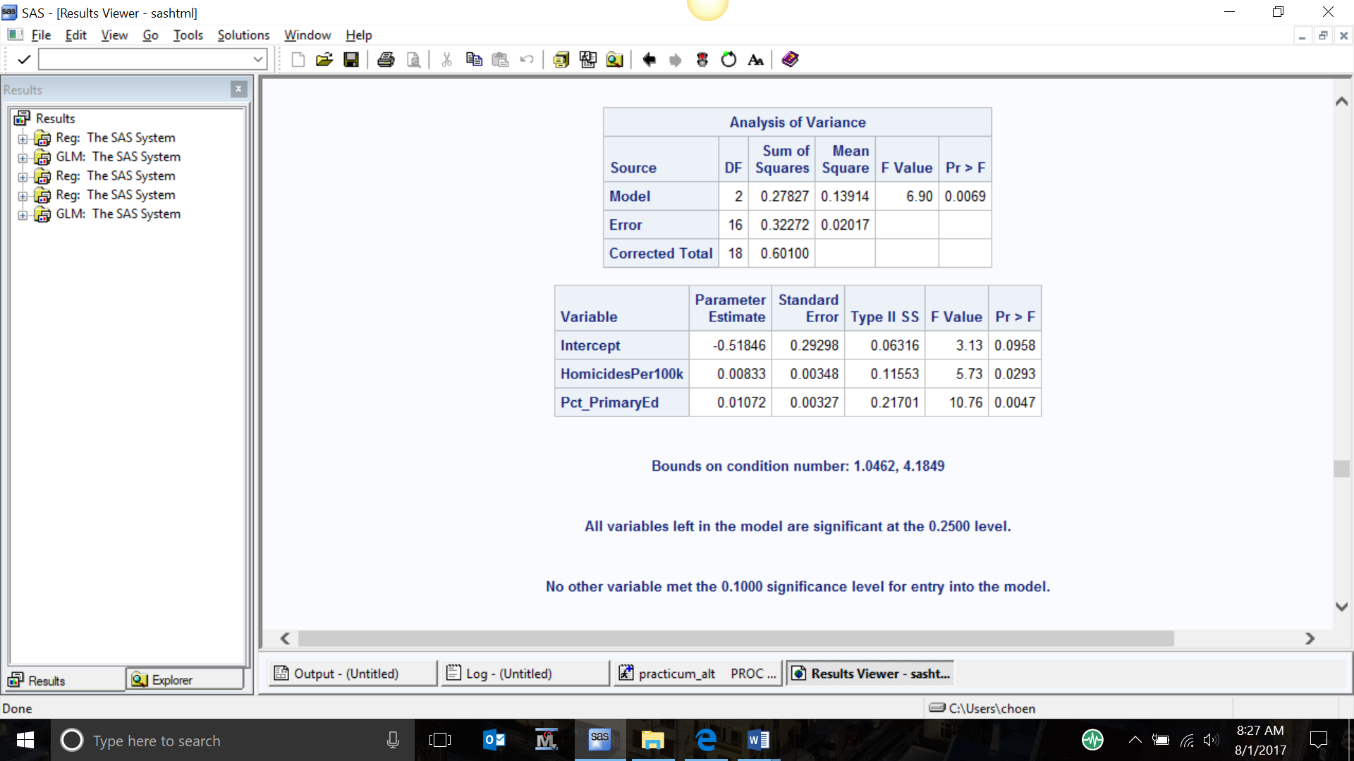
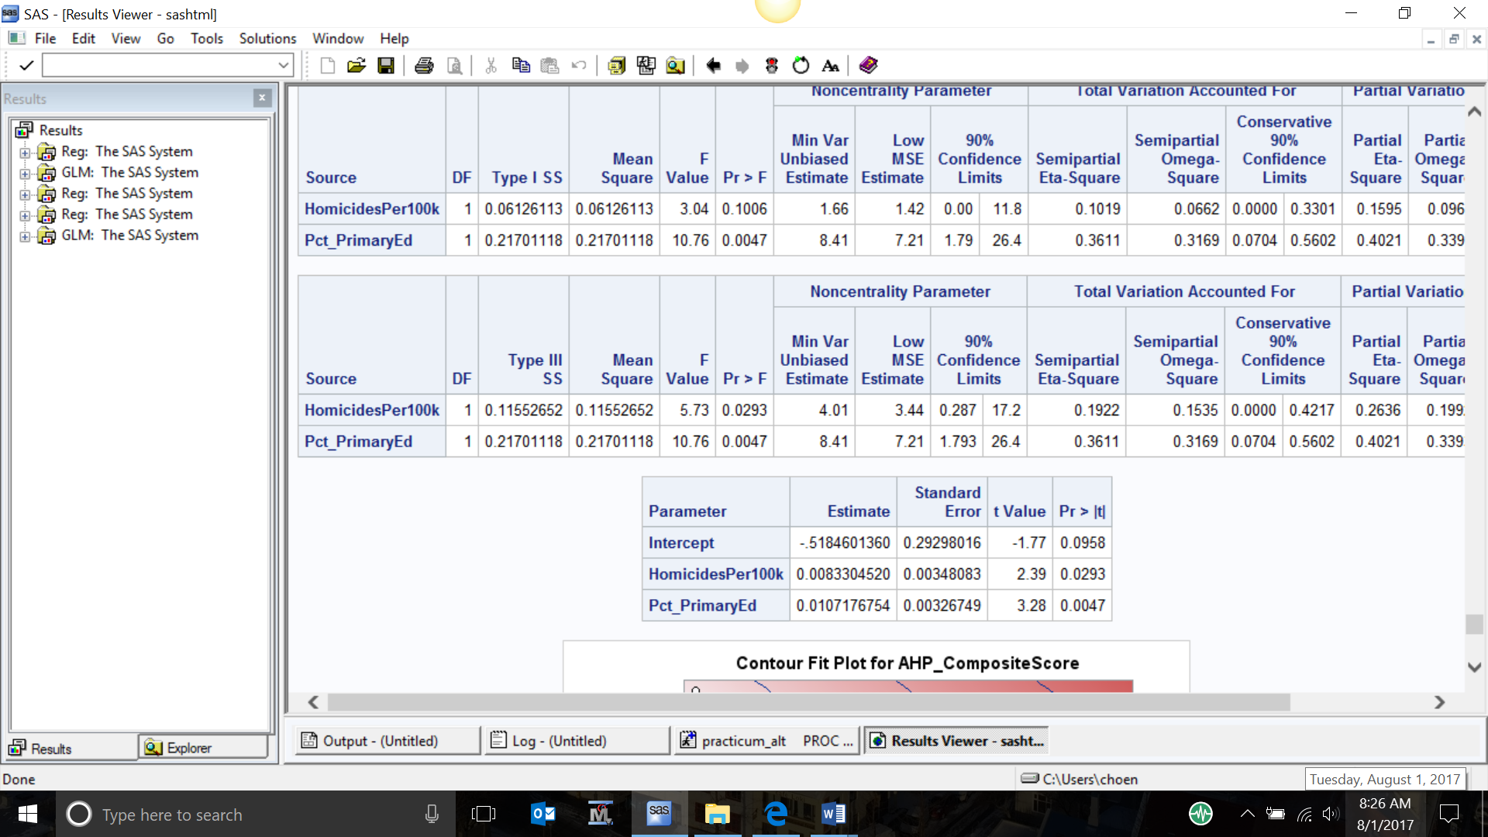
Appendix (AHP Linear Regression)
/* stepwise regression */
proc reg data=AHP_v1;
model AHP_CompositeScore = Incr_GDPPerCapita -- Pct_Sanitation / selection=stepwise slentry=0.1 slstay=0.25;
run;
39

Slide 40
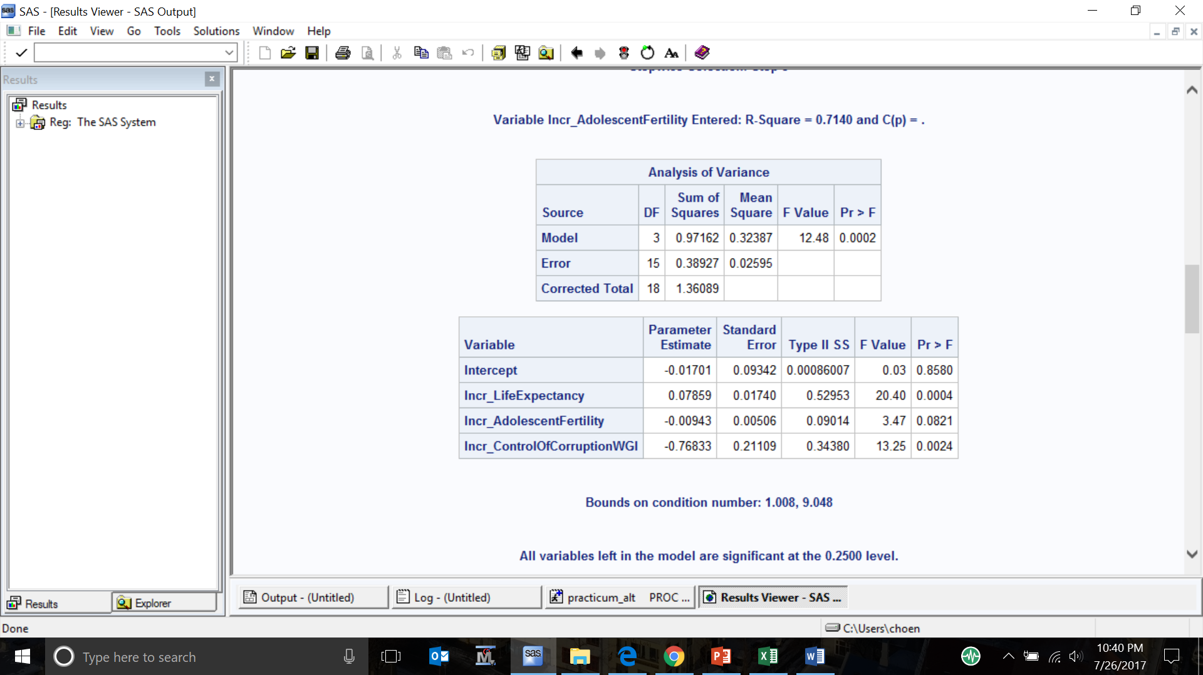
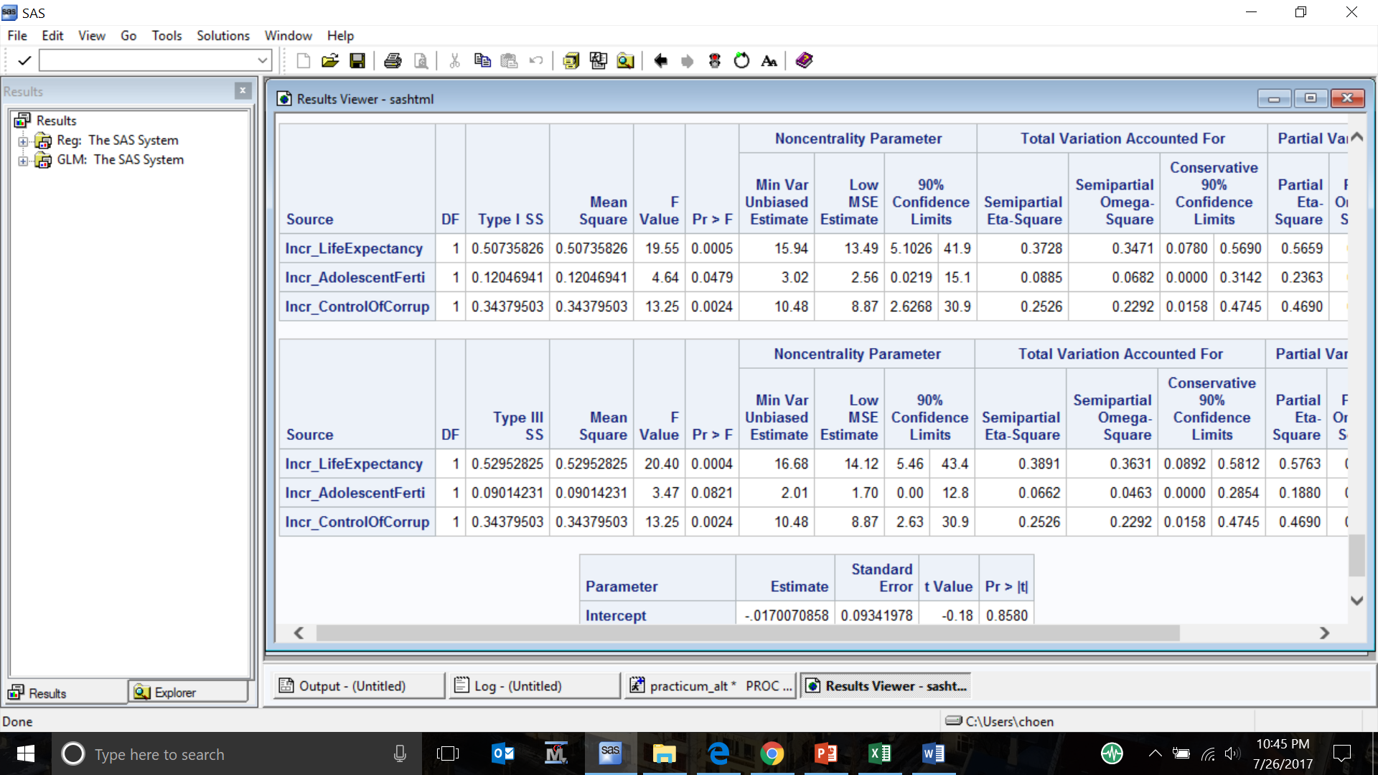
Appendix (DEA Linear Regression)
/* stepwise regression */
proc reg data=DEA;
model DEA_Efficiency = Incr_GDP_Per_Capita -- Incr_ControlOfCorruptionWGI / selection=stepwise slentry=0.1 slstay=0.25;
run;
40

Slide 41
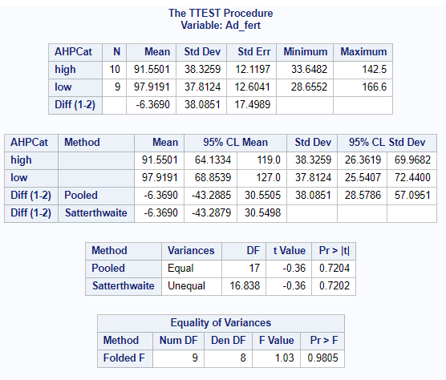
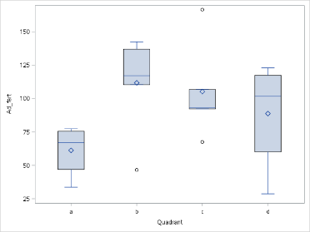
Appendix (AHP Student’s t-tests)
proc ttest data=quadrants;
var ad_fert;
class AHPCat;
run;
41

Slide 42
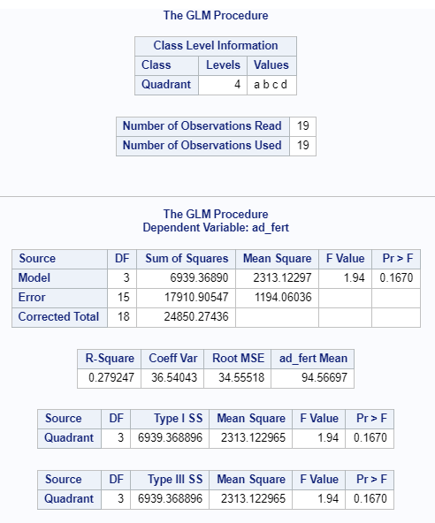
Appendix (Teenage Fertility Ratio Scheffe test)
proc glm data=quadrants;
class quadrant;
model ad_fert = quadrant;
means quadrant / scheffe cldiff;
run;
41

Slide 43
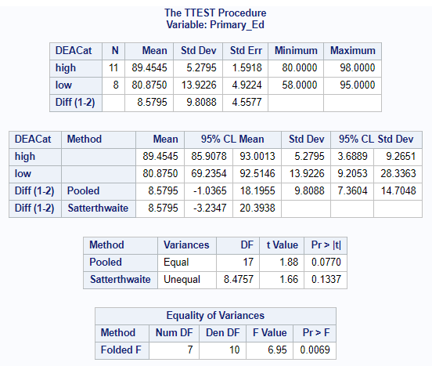
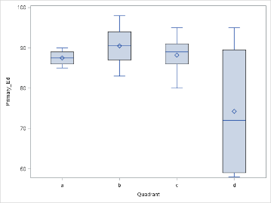
Appendix (DEA Student’s t-tests)
proc ttest data=quadrants;
var primary_ed;
class DEACat;
run;
42

Slide 44

Appendix (Primary education ratio Scheffe test)
proc glm data=quadrants;
class quadrant;
model primary_ed = quadrant;
means quadrant / scheffe cldiff;
run;
42

